Slide 1
Open Platform for NFV (OPNFV)

Slide 2
Introduction to OPNFV
OPNFV is a carrier-grade, integrated, open source platform to accelerate the introduction of new NFV products and services.
The goals of OPNFV
Develop an integrated and tested open source platform
Meet the needs of user community
Contribute to and participate in relevant open source projects
Establish an ecosystem for NFV solutions based on open standards and software

Slide 3
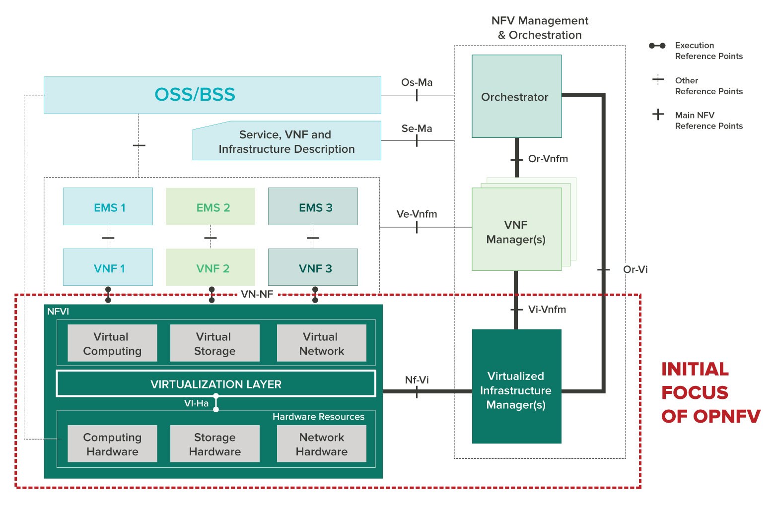
ETSI NFV Architecture Framework
OPNFV primarily focuses on NFVI

Slide 4
OPNFV Releases
Release | Version | Release Date
Colorado | 2.0 | Mon, 11/14/2016
Colorado | 1.0 | Mon, 09/26/2016
Brahmaputra | 3.0 | Fri, 04/29/2016
Brahmaputra | 2.0 | Thu, 04/21/2016
Brahmaputra | 1.0 | Tue, 03/01/2016
Arno | SR1 | Thu, 10/01/2015
Arno | 1.0 | Thu, 06/04/2015

Slide 5
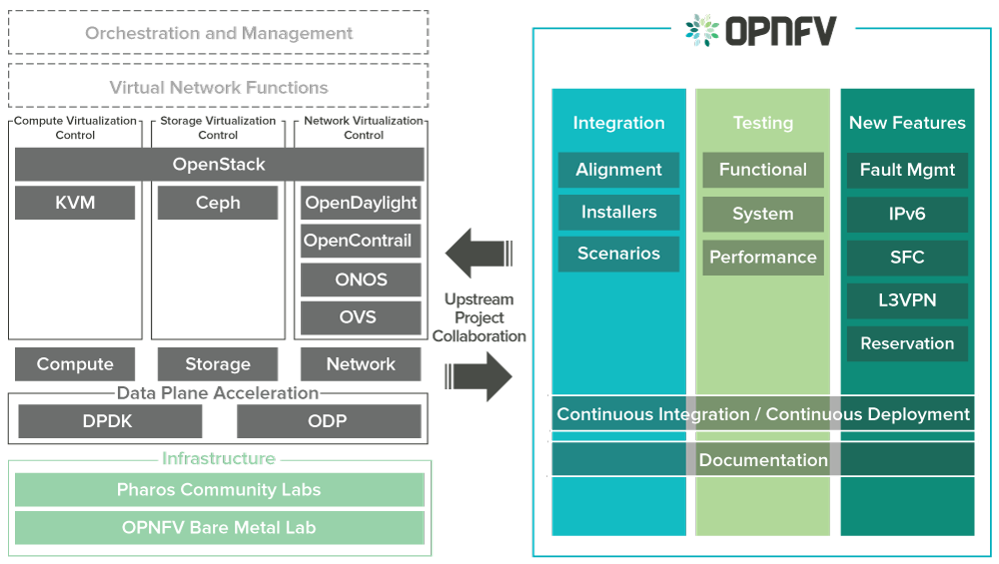
OPNFV Overview
There are three scopes in OPNFV
Notes:
DPDK = Intel data plane development kit, add text to describe the point

Slide 6
OPNFV: Integration
OPNFV integrate open source projects
Notes:
DPDK = Intel data plane development kit

Slide 7
Software
Based on our needs, we enable some components when deploying OPNFV
Category | Enabled
VM hypervisor | KVM
OpenFlow Controller | OpenDaylight
Virtual switch | OVS

Slide 8
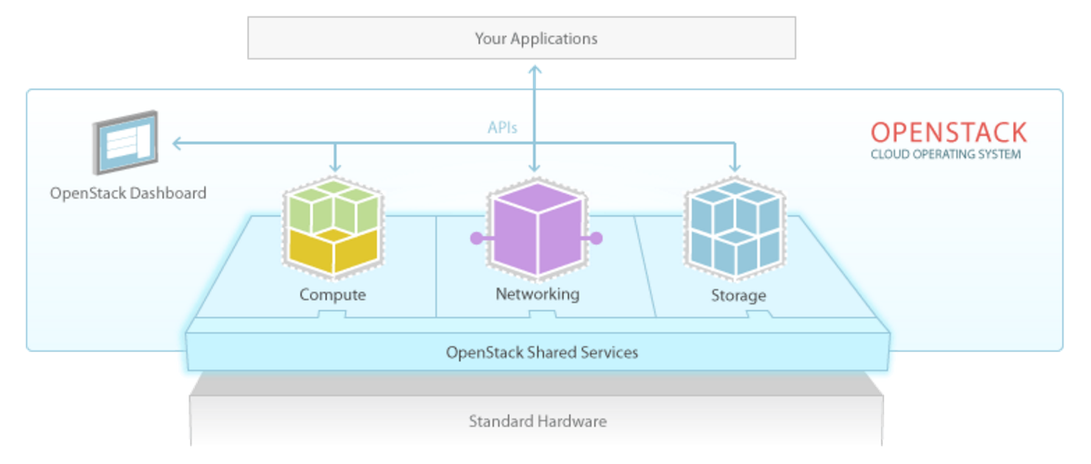
OpenStack Components
Compute Components
API Server (nova-api)
Message Queue (Rabbit-mq server)
Compute Workers (nova-compute)
Network Controller (nova-network)
Volume Worker (nova-volume)
Scheduler (nova-scheduler)
Image Service (Glance)
Dashboard
User Interface (horizon)
Service Object Storage
Storage Infrastructure (swift)
Security and Users
Identity Service (keystone)
Database (mysql)

Slide 9
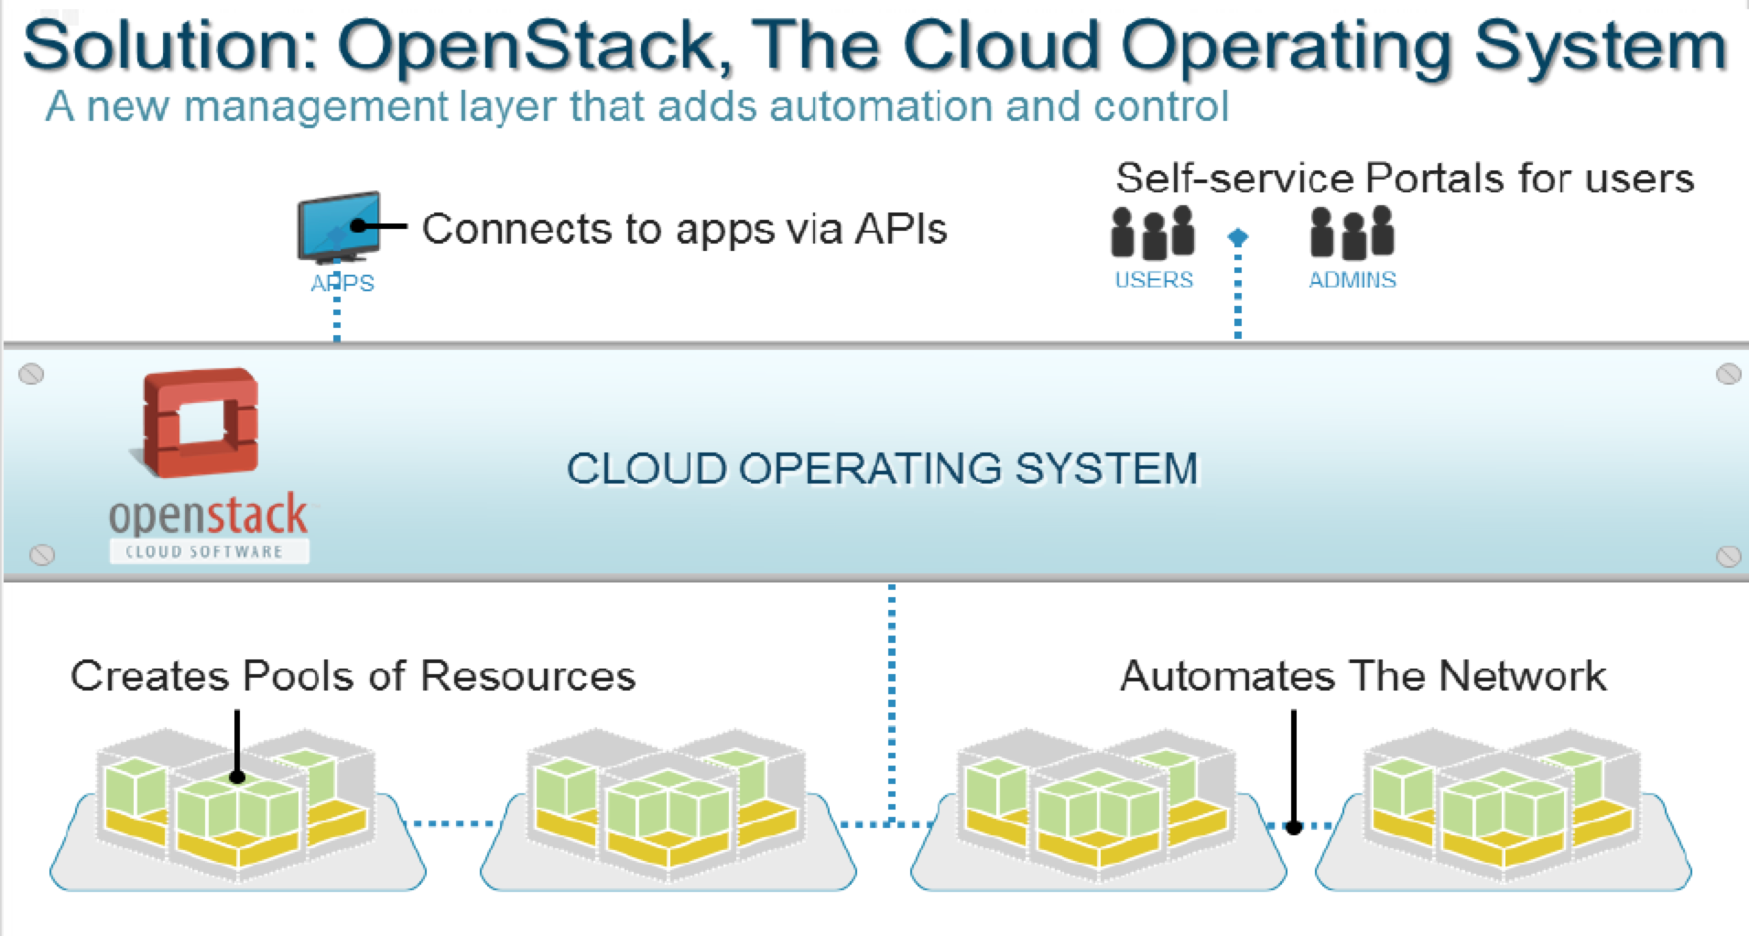
Automation and Orchestration of IT Resources
Notes:
A Cloud Computing platform sits above the virtual data center and provides both a control plane over and resource access to the virtualized data center. OpenStack, as a Cloud Computing platform, manages virtualized resources, such as virtual machines exported by a hypervisor, network overlays created by Software-Defined Network devices, and volumes exported by virtual storage arrays. OpenStack takes these data center resources and automates and orchestrates them so they can be accessed on demand and be scaled up and down as needed, turning these resources into consumable services.

Slide 10
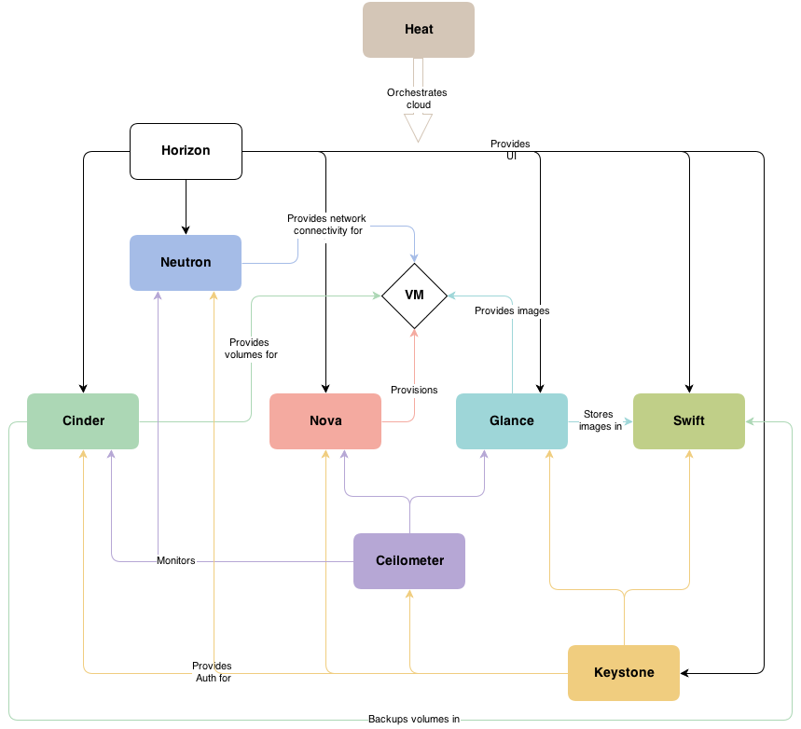
In a Loosely Coupled Architecture

Slide 11
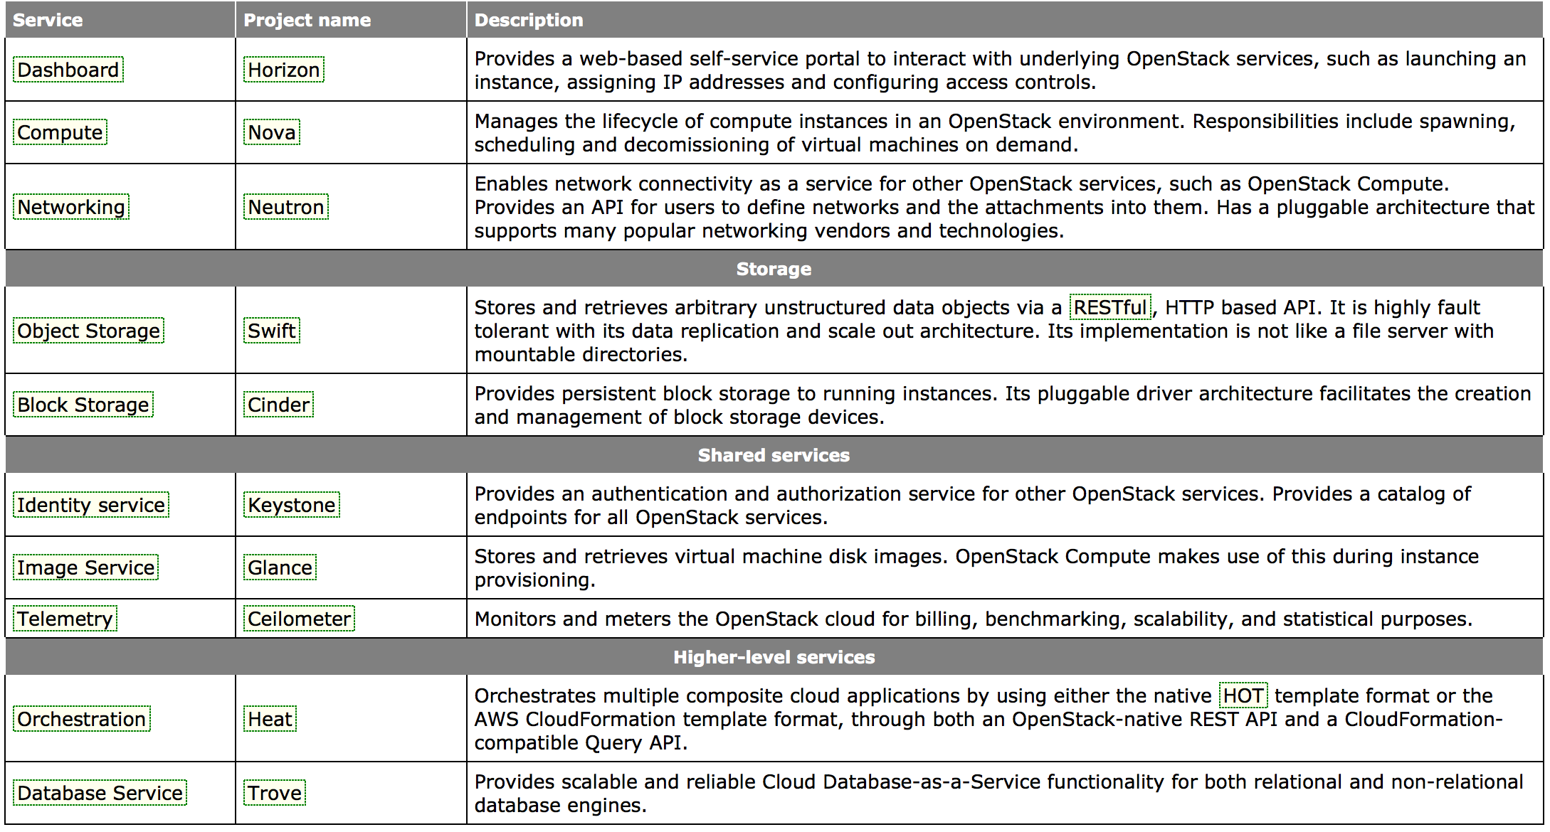
By Leveraging Various Open Source Projects
Notes:
The OpenStack platform is actually composed of multiple components, called projects. Each project is managed by a technical committee and the OpenStack Foundation decides which projects are ready to be included in the OpenStack core. These projects work together to provide the services required to deliver the Cloud.
Nova – The compute project responsible for on-demand creation and termination of compute instances. Nova leverage a number of hypervisors, including KVM, Xen, Hyper-V, and vSphere.
Glance – The OS image management project responsible for storage and management of images used to create compute instances with OSes installed, such as Windows and Linux.
Quantum – The network project that provides network access and security services to compute instances. Quantum uses plugins to leverage virtual switches and SDN-enabled devices.
Swift – The object storage project that provides a scalable repository for storing large quantities of objects such as files and media content. It can also be used as an repository for Glance images.
Cinder – The block storage project that provides a virtual storage array that can export out iSCSI volumes. A Cinder/virtual storage array server can be a server with local storage or a server using an external storage array.
Horizon – The interactive dashboard project that provides users and admins provisioning and management access to the OpenStack Cloud via a web GUI.
Keystone – The identity management project that provides authorization and access security control for all the other OpenStack projects.
New projects are being added with each release and as the OpenStack community calls for them. New projects underway include metering, application orchestration, and database-as-a-service.

Slide 12
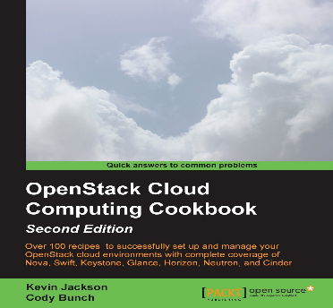
Reading About OpenStack
The OpenStack Foundation
http://www.openstack.org/
Official OpenStack Documentation
http://docs.openstack.org/
The OpenStack Cloud Computing Cookbook (Second Edition)
http://www.amazon.com/OpenStack-Cloud-Computing-Cookbook-Jackson/dp/1782167587/ref=sr_1_1?s=books&ie=UTF8&qid=1382033707&sr=1-1

Slide 13
OpenStack Nodes
Traditionally, different nodes are deployed in different physical machines (hosts)
Inter-subnet communication should go a network node → higher latency
We combine the functions of compute and network nodes
Control node
Compute node
Network node
OpenStack Controller
Running VMs
vRouter to connect VMs in different virtual subnets

Slide 14
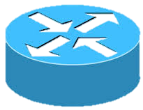
Deployment Plan: Software
OpenStack Controller
OpenDaylight
OpenStack Agent
VM
vRouter
OVS
Controller node
DPDK
L3 Agent
Control plane
Compute node
Network node
Host 1
Host 3
Switch
OpenStack Agent
VM
vRouter
OpenStack Controller
OpenDaylight
OVS
DPDK
L3 Agent
Controller node
Compute node
Network node
Host 2
Host 4
Switch
Data plane
…
Two control nodes for HA
Enable L3 agent to run network node functions in compute nodes
OpenStack Agent
VM
vRouter
OVS
DPDK
L3 Agent
Compute node
Network node
Host 8
Notes:
只留兩台compute node

Slide 15
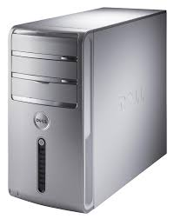
Availability Zones
We can aggregate compute nodes as available zones
Zone 2: Larger MEM
Zone 1: Fast CPU
Zone 3: DPDK Enabled
Notes:
Add text

Slide 16
Inter-subnet Communication with Floating IP
Clients can create their own subnets and connect them to a cloud network
Inter-subnet communication relies on floating IPs
Private Subnet 2
10.1.1.0/24
VM
Private Subnet 1
172.16.1.0/24
Cloud Network
192.168.100.0/24
VM
10.1.1.4
172.16.1.3
Floating IP
192.168.100.123
vRouter
vRouter

Slide 17
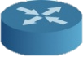
Inter-subnet Communication with Floating IP
However, long route and floating IP translation are overhead and make throughput drop
192.168.100.123
192.168.100.123
Floating IP
172.16.1.3
10.1.1.4
iPerf
Server
Issue 1:
IP translation
iPerf
Client
VM
VM
V
V
OVS
OVS
L3 Agent
Compute node
Compute node
Network node
Host
Host 1
Host
Issue 2:
Long Route
Public Net: 140.96.102.0/24
Subnet 1: 172.16.1.0/24
Subnet 2: 10.1.1.0/24

Slide 18
Solution for Issue 1
Based on our survey, we can connect subnets via a vRouter, and the vRouter forward traffic based on subnet prefix
We save the floating IP translation overhead
Private Subnet 2
10.1.1.0/24
Private Subnet 1
172.16.1.0/24
VM
VM
10.1.1.4
172.16.1.3
vRouter

Slide 19
Solution for Issue 2
To Solve the long route issue
We deploy vRouter closer to VMs
Floating IP
VM
VM
V
V
OVS
OVS
L3 Agent
Compute node
Compute node
Network node
Host
Host 1
Host

Slide 20
Availability Zones for Routers
Nodes are grouped as availability zones for vRouters
L3 agents are deployed in each compute node to enable vRouter availability zones
V
vRouter
L3 Agent
L3 Agent
Network node
L3 Agent
Network node
Host
Network node
Host
Host
Zone 2
Zone 1

Slide 21

Define Router Availability Zones
An administrator defines vRouter availability zones
We setup the attribute “availability_zone” in neutron.conf to define the availability zone
availability_zone = Zone-2
availability_zone = Zone-2
availability_zone = Zone-1
Administrator
L3 Agent
L3 Agent
Network node
L3 Agent
Network node
Host
Network node
Host
Host
Zone 2
Zone 1

Slide 22

Assign Availability Zones to Routers
Cloud users defines their own private networks
Then, define a vRouter, and assign an availability zone to the vRouter
Connect the vRouter to their private networks
Other Network
Private Network
User
neutron router-create --availability-zone-hint Zone-1 router
Notes:
定義設定zone的流程以及administrator可做什麼？User可以做什麼?

Slide 23
vRouter Placement
Users can put VM and vRouter to the same availability zone for shorter latency
User
VM 1
V
VM 2
OVS
L3 Agent
Compute node
Network node
OVS
L3 Agent
Host
Compute node
Network node
Host
Zone 1

Slide 24
vRouter Relocation and Directly Routing
We move the vRouter to compute node by specifying its availability zone and directly connect two subnet by using the vRouter
Directly Routing
172.16.1.3
10.1.1.4
iPerf
Server
192.168.100.4
iPerf
Client
V
Floating IP
VM
VM
OVS
L3 Agent
OVS
L3 Agent
L3 Agent
Compute node
Network node
Compute node
Network node
Network node
Host
Host
Host
Shorter Route
Public Net: 192.168.100.0/24
Subnet 1: 172.16.1.0/24
Subnet 2: 10.1.1.0/24

Slide 25
Boot up VMs
There are some steps to boot up a VM
VM Image
I
I
I
VM Instance
I
Image DB
Compute Node
Prepare an Image for the VNF
Register the image with the platform
Activate VNF instance in a compute node
Create Networks
Connect the VMs to the Networks

Slide 26
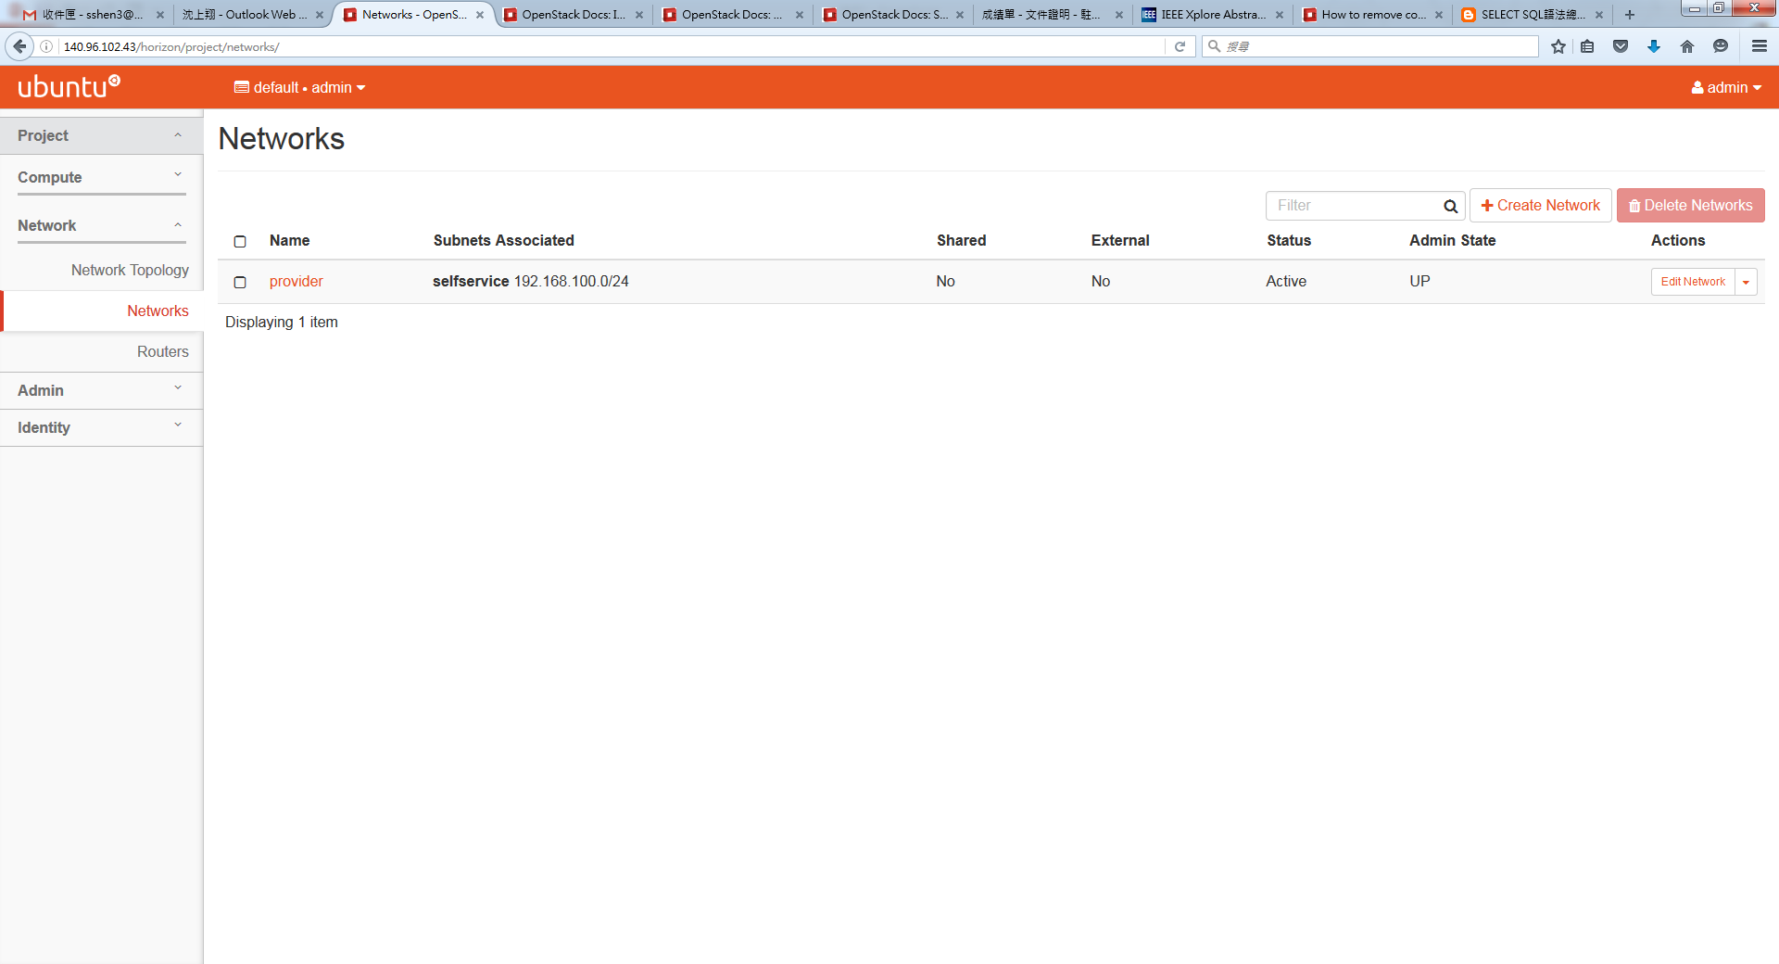
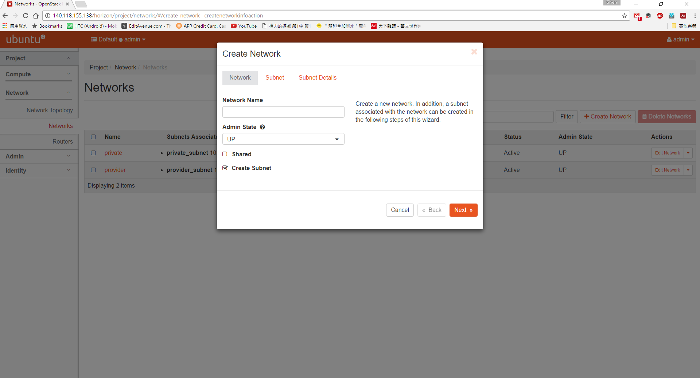
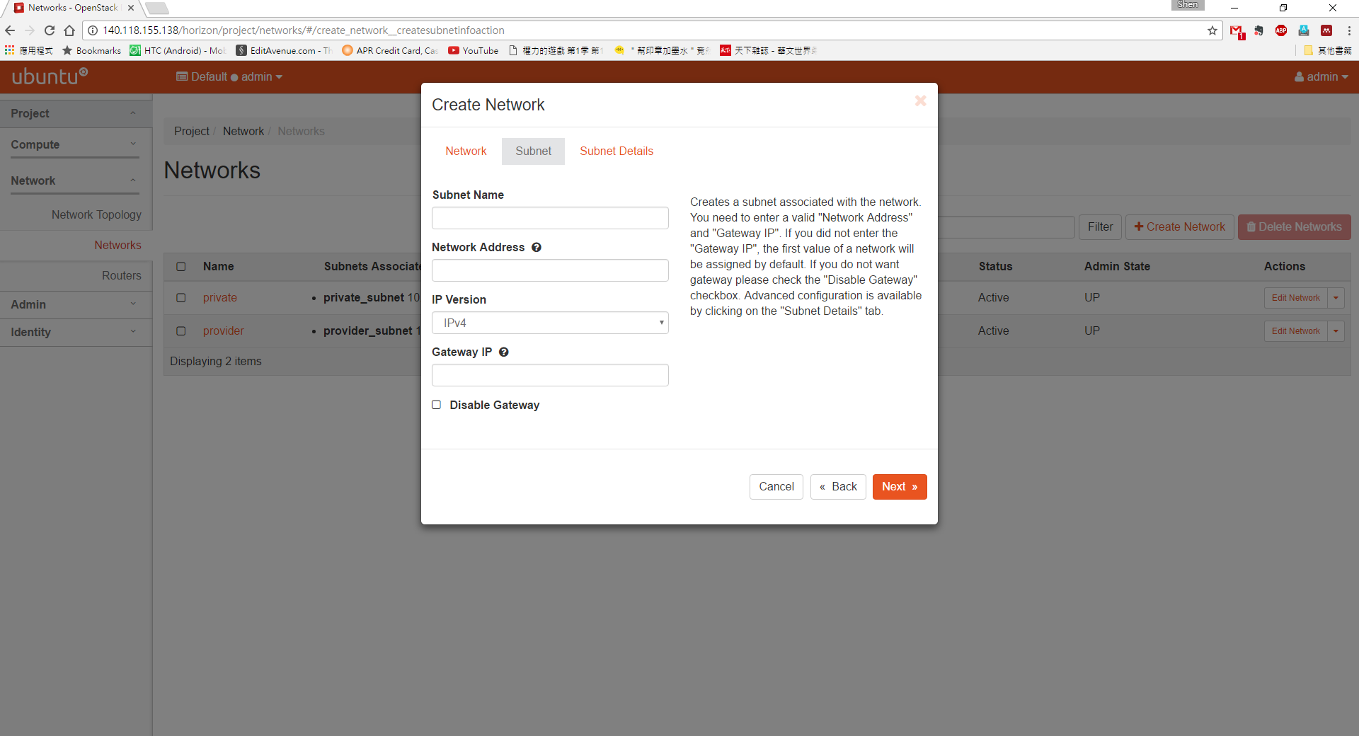
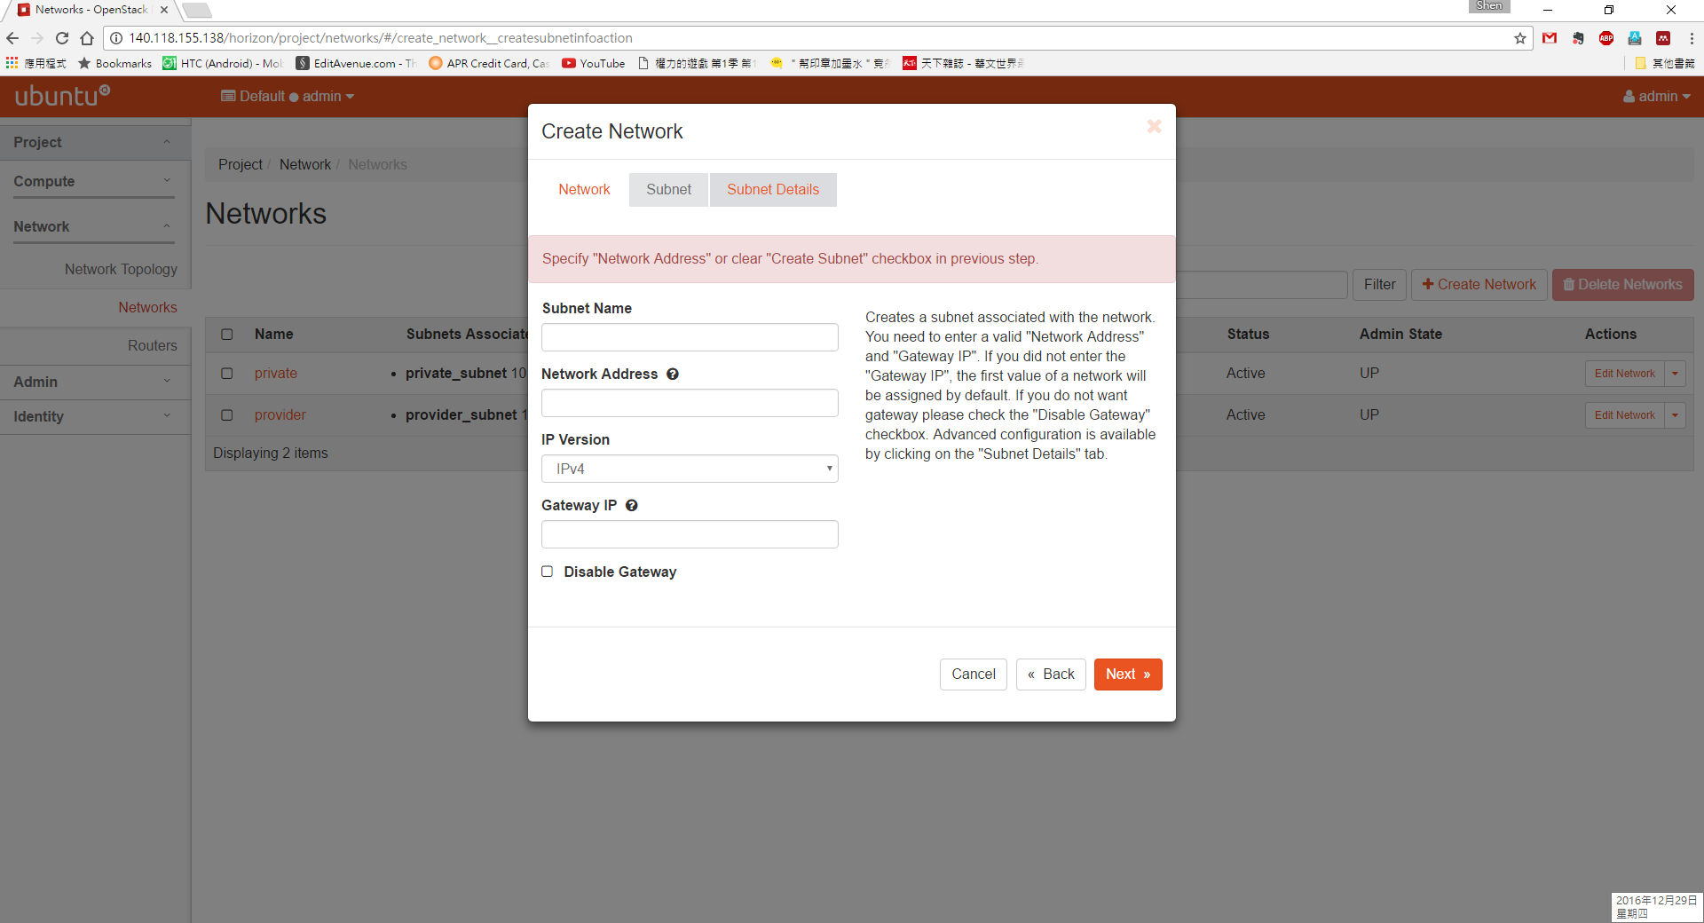
Create Network

Slide 27
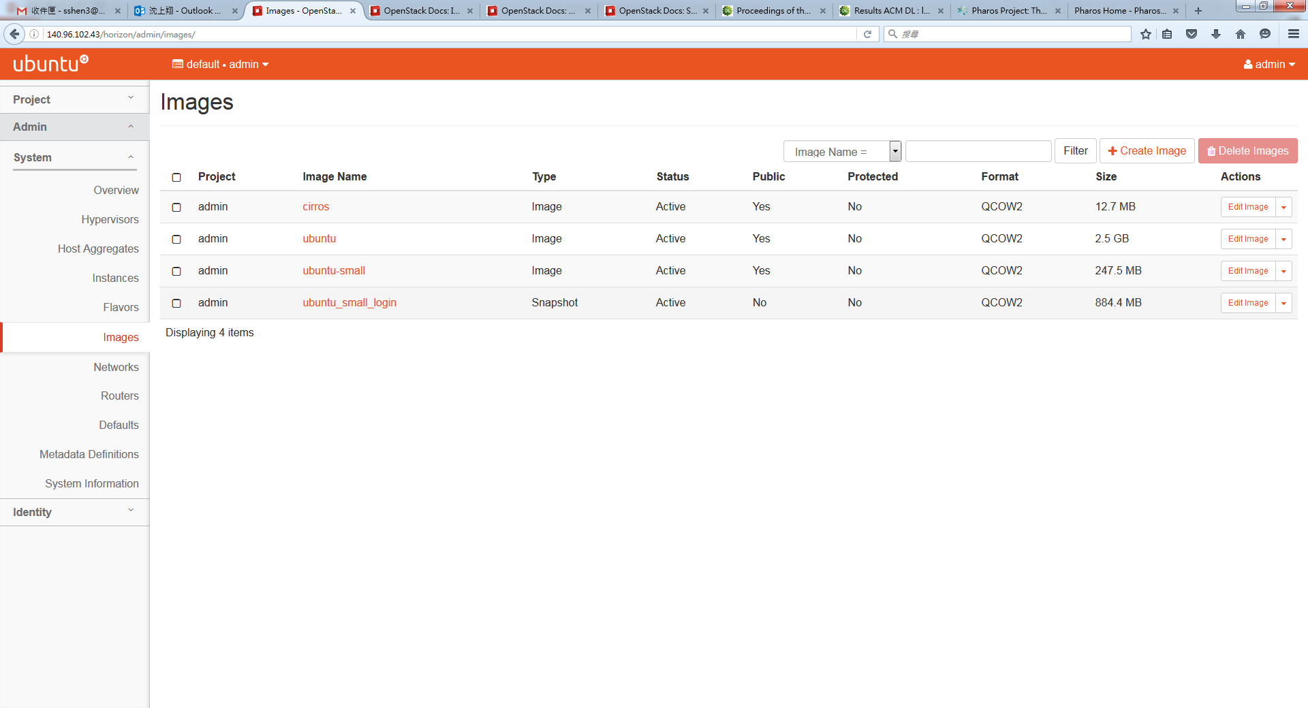
VM Images

Slide 28
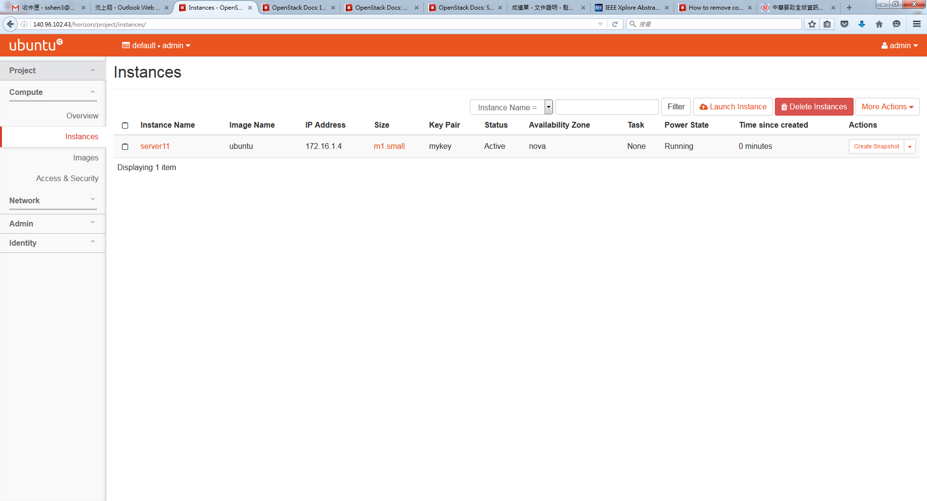
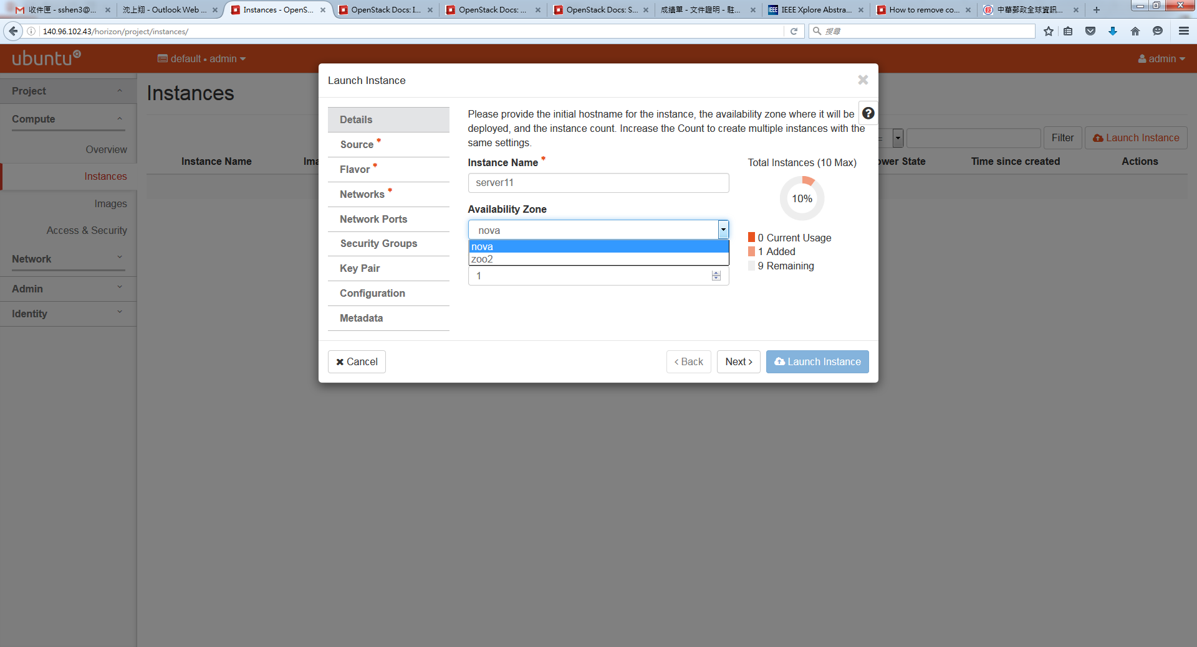
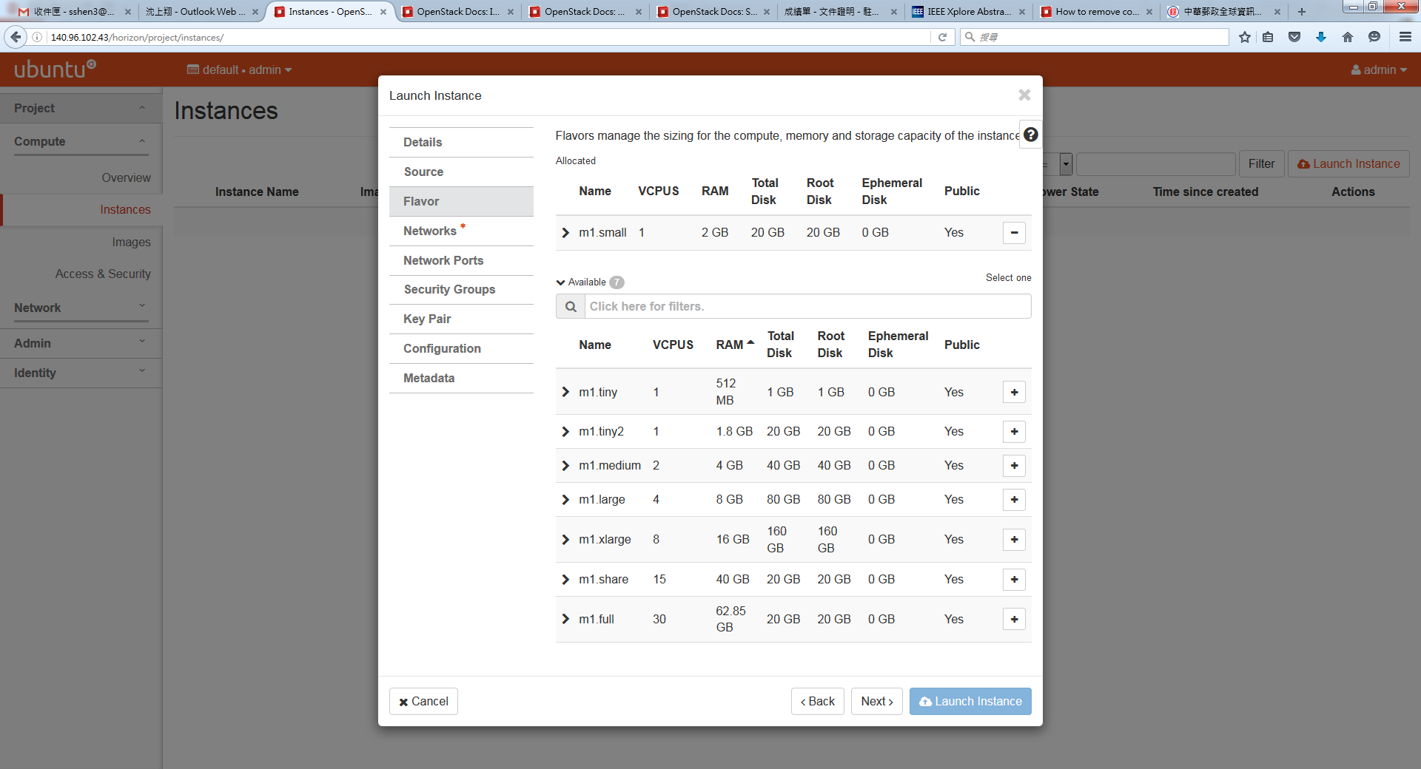
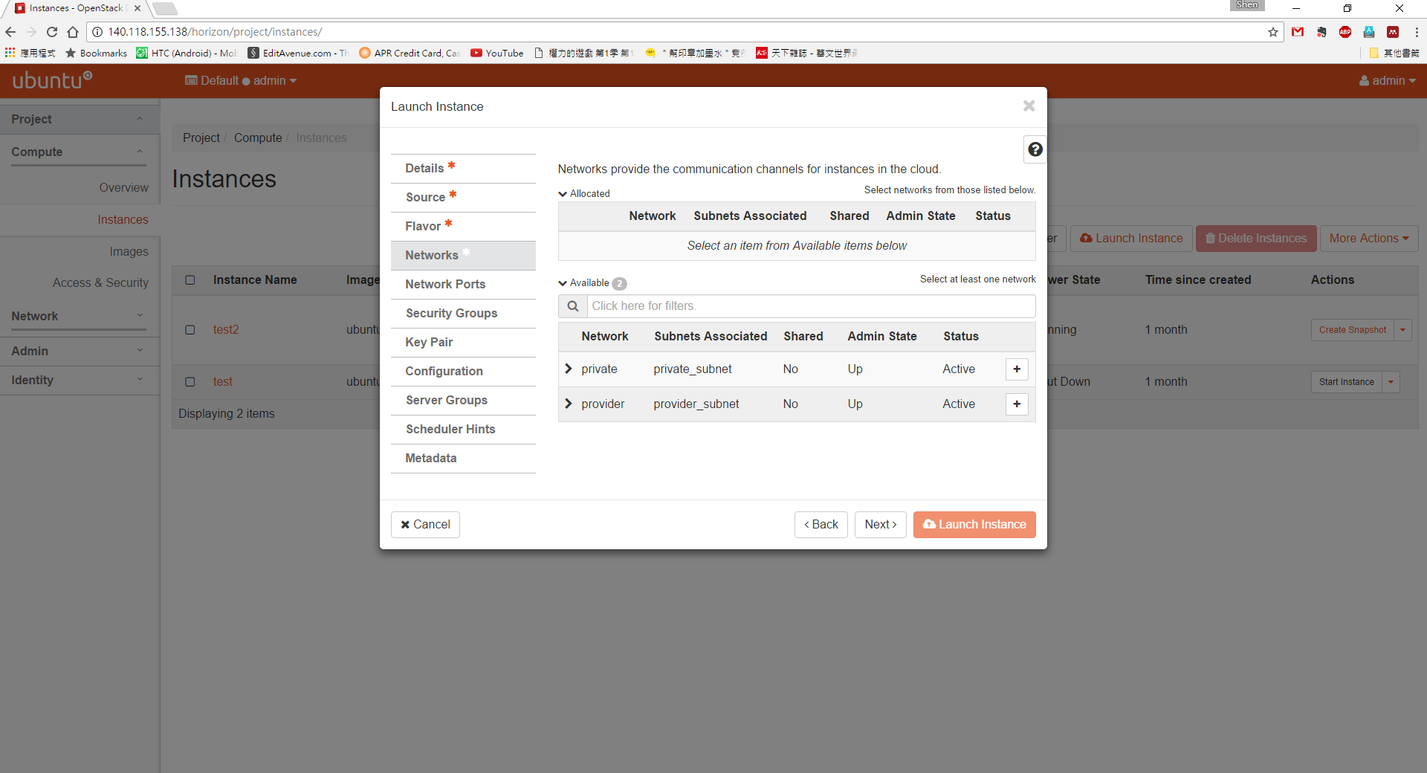
Create VM

Slide 29
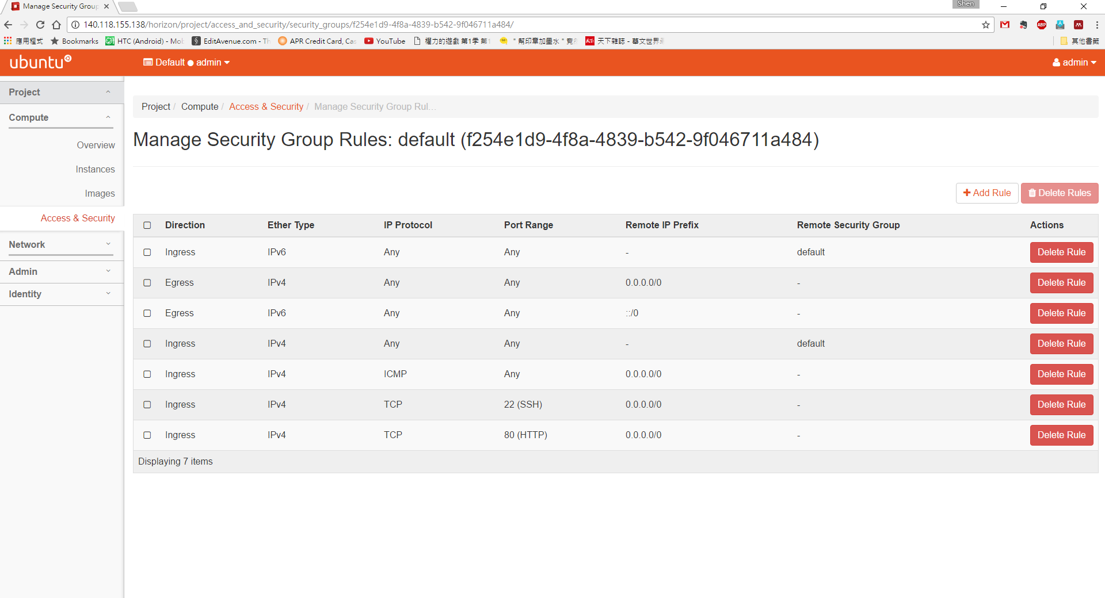
Security Group

Slide 30
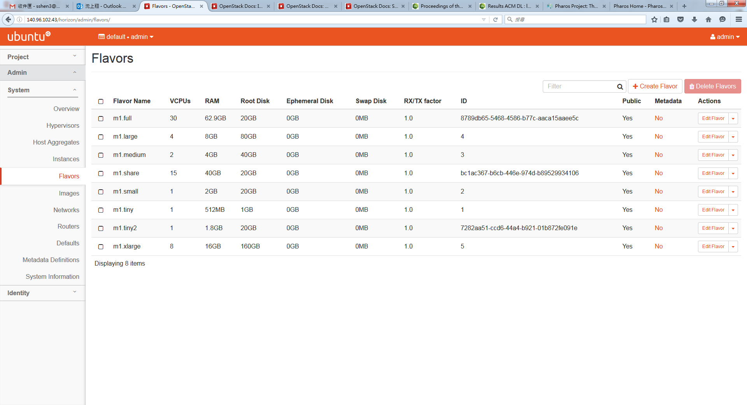
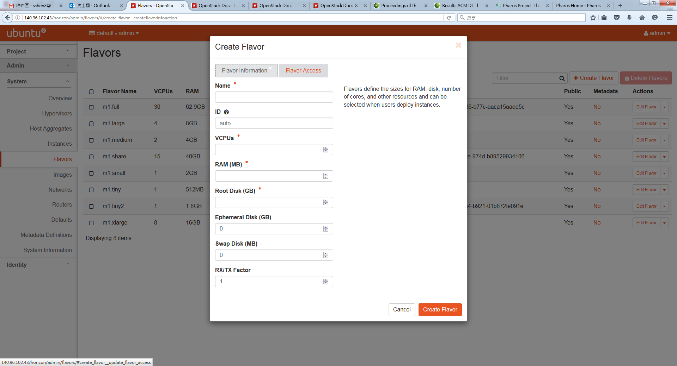
Define Flavors

Slide 31
Availability Zones
We can aggregate compute nodes as available zones
Zone 2: Larger MEM
Zone 1: Fast CPU
Zone 3: DPDK Enabled
Notes:
Add text

Slide 32
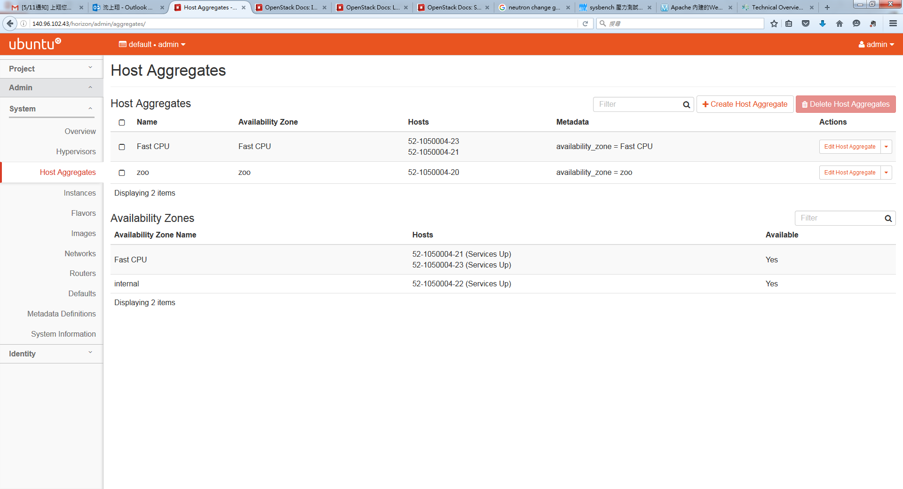
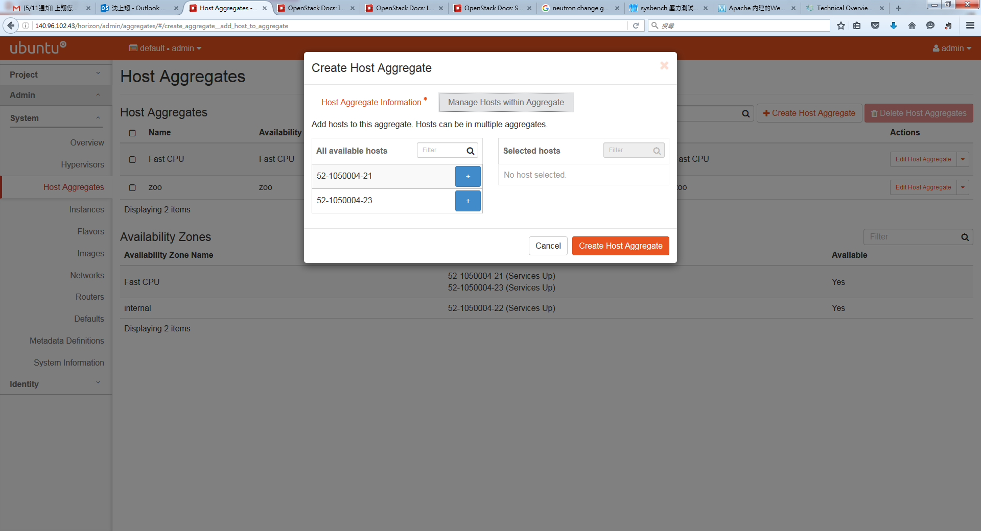
Availability Zones

Slide 33
Inter-subnet Communication
VMs in different subnet can communicate with each other via floating IP and vRouter
VM
OVS
Compute node
VM
OVS
172.16.1.5
Compute node
192.168.100.103
Floating IP
vRouter
vRouter

Slide 34
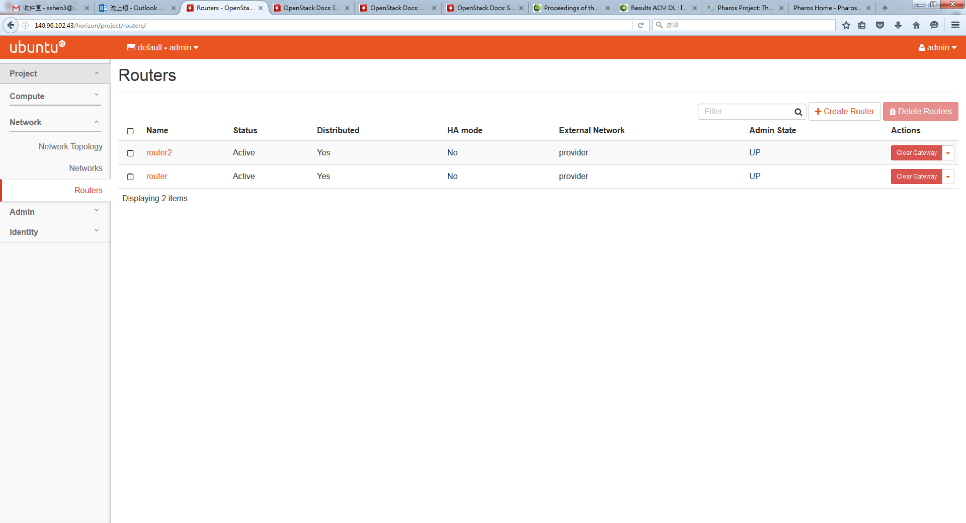
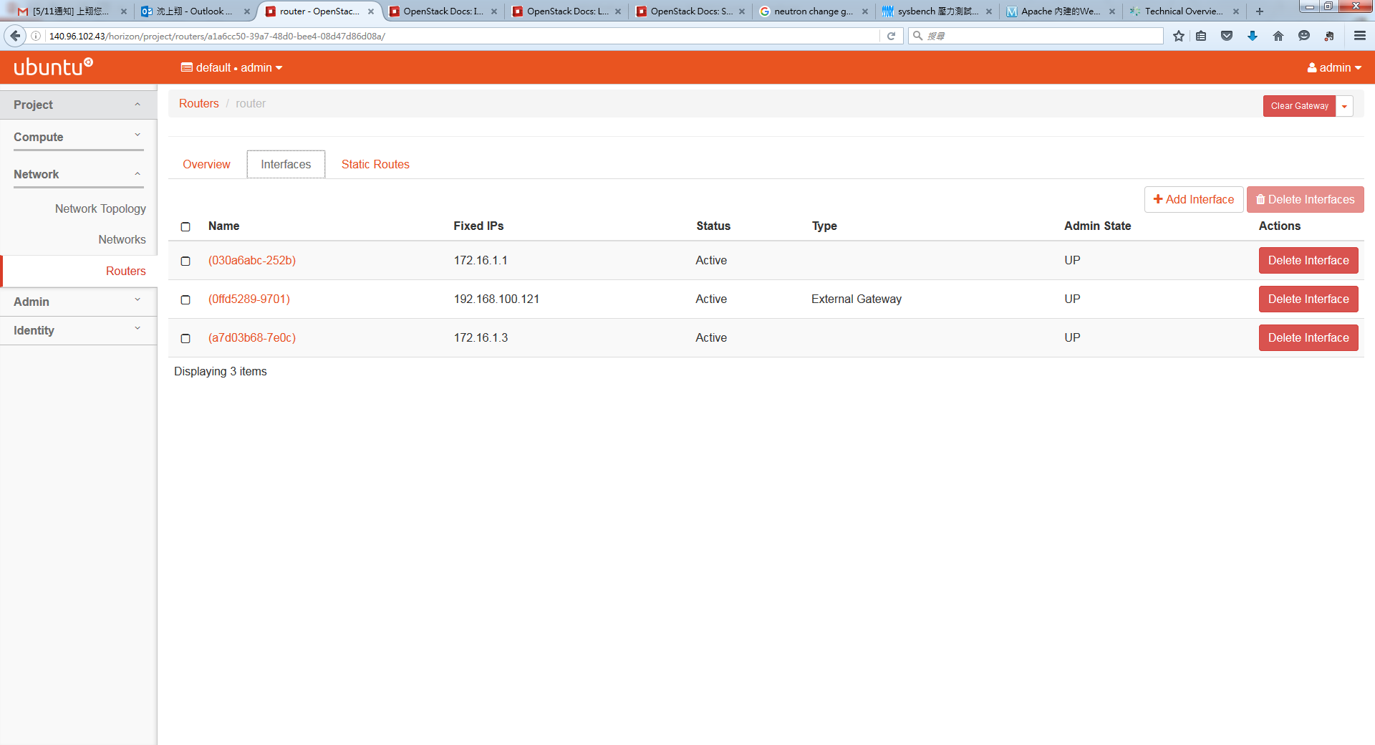
Router Setup

Slide 35
DevStack
Download DevStack
git clone https://git.openstack.org/openstack-dev/devstack
Check folder to devstack
Cd devstack
Copy local.conf from ~/devstack/samples
cp ./samples/local.conf .
Edit local.conf add the following line
HOST_IP=10.0.2.15
Change the password as you want
ADMIN_PASSWORD=admin
DATABASE_PASSWORD=stackdb
RABBIT_PASSWORD=stackqueue
SERVICE_PASSWORD=servicepassword

Slide 36
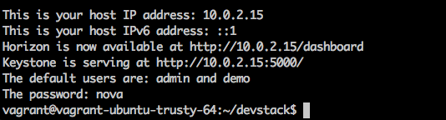
DevStack
Install DevStack
./stack.sh
You can see the following messages

